Slide 1
Lec:6 Software Engineering Ethics and Professional Practices
15

Slide 2
What is SEEPP?
Stands for
Software Engineering Ethics and Professional Practices
Goal: Establish a code of conduct for professional software engineers to make software engineering a beneficial and respected profession.
Joint Effort by IEEE-Computer Society and Association of Computing Machinery(ACM)

Slide 3
What is Software?
Computers have a central and growing role in commerce, industry, government, medicine, education, entertainment and society at large
Software Engineers develop software to automate / facilitate other areas of society
Thus Role of software in medicine, education, government, industry, commerce etc is “Key”

Slide 4
Software Engineers in focus
Because of their roles in developing software systems, software engineers have significant opportunities to
  Do good or cause harm
  Enable others to do good or cause harm
  Influence others to do good or cause harm

Slide 5
Who are the Engineers?
Software engineers are those who contribute either by direct participation or by
  teaching,
  analyzing,
  Specification generating,
  designing,
  developing,
  certifying,
  Maintaining and
  testing
of software systems

Slide 6
Roles of Engineers
“Professional Software Engineers” include
  Practitioners
  Educators
  Managers
  Supervisors
  and Policy makers
Trainees and Students of the Profession

Slide 7
8 Key Principles:
Product
Public
Judgement
Client and Employer
Management
Profession
Colleagues
Self

Slide 8
Principle 1: Products
1.01 Ensure adequate software specification
1.02 Understand specifications fully
1.03 Ensure you are suitably qualified
1.04 Ensure all goals are achievable
1.05 Ensure proper methodology use
1.06 Ensure good project management
1.07 Ensure all estimates are realistic
1.08 Ensure adequate documentation
1.09 Ensure adequate testing and debugging
1.10 Promote privacy of individuals
1.11 Use data legitimately
1.12 Delete outdated and flawed data
1.13 Identify and address contentious issues
1.14 Promote maximum quality and minimum cost
1.15 Follow appropriate industry standards

Slide 9
Principle 2: Public
2.01 Disclose any software-related dangers
2.02 Approve only safe, well tested software
2.03 Only sign documents in area of competence
2.04 Cooperate on matters of public concern
2.05 Produce software that respects diversity
2.06 Be fair and truthful in all matters
2.07 Always put the public’s interests first
2.08 Donate professional skills to good causes
2.10 Accept responsibility for your own work

Slide 10
Principle 3: Judgement
3.01 Maintain professional objectivity
3.02 Only sign documents within your responsibility
3.03 Reject bribery
3.04 Do not accept secret payments from the client
3.05 Accept payment from only one source for a job
3.06 Disclose conflicts of interest
3.07 Avoid conflicting financial interests
3.08 Temper technology judgments with ethics

Slide 11
Principle 4: Client and Employer
4.01 Provide services only where competent
4.02 Ensure resources are authentically approved
4.03 Only use property as authorized by the owner
4.04 Do not use illegally obtained software
4.05 Honor confidentiality of information
4.06 Raise matters of social concern
4.07 Inform when a project becomes problematic
4.08 Accept no detrimetaln outside work
4.09 Represent no interests adverse to your employer

Slide 12
Principle 5: Management
5.01 Assure standards are known by employees
5.02 Assure knowledge of confidentiality protocols
5.03 Assign work according to competence
5.04 Provide due process for code violations
5.05 Develop fair ownership agreements
5.06 Accurately describe conditions of employment
5.07 Offer only fair and just remuneration
5.08 Do not prevent a subordinate’s promotion
5.09 Do not ask a person to breach this code

Slide 13
Principle 6: Profession
6.01 Associate with reputable people
6.02 Promote commitment of this code
6.03 Support followers of this code
6.04 Help develop an ethical environment
6.05 Report suspected violations of this code
6.06 Take responsibility for errors
6.07 Only accept appropriate remuneration
6.08 Be accurate and honest regarding software
6.09 Place professional interests before personal
6.10 Obey all laws governing your work
6.11 Exercise professional responsibility
6.12 Promote public knowledge of the subject
6.13 Share software knowledge with the profession

Slide 14
Principle 7: Colleagues
7.01 Assist colleagues in professional development
7.02 Review other’s work only with their consent
7.03 Credit fully the work of others
7.04 Review others work candidly
7.05 Give fair hearing to colleagues
7.06 Assist colleagues’ awareness of work practices
7.08 Do not hinder a colleague’s career
7.09 Do not pursue a job offered to a colleague
7.10 Seek help with work outside your competence

Slide 15

Need for Code of Ethics

Slide 16
Principle 8: Self
8.01 Further your own professional knowledge
8.02 Improve your ability to produce quality work
8.03 Improve your ability to document work
8.04 Improve your understanding of work details
8.05 Improve your knowledge of relevant legislation
8.06 Improve your knowledge of this code
8.07 Do not force anyone to violate this code
8.08 Consider code violations inconsistent with
software engineering

Slide 17

Corporations as Moral Agents
Corporations are increasingly viewed as moral agents that are accountable for their conduct to stakeholders
  Society holds companies accountable for employee conduct, their decisions and the consequences
Laws and regulations are necessary to provide formal structural restraints and guidance on ethical issues
Source: Digital Vision

Slide 18
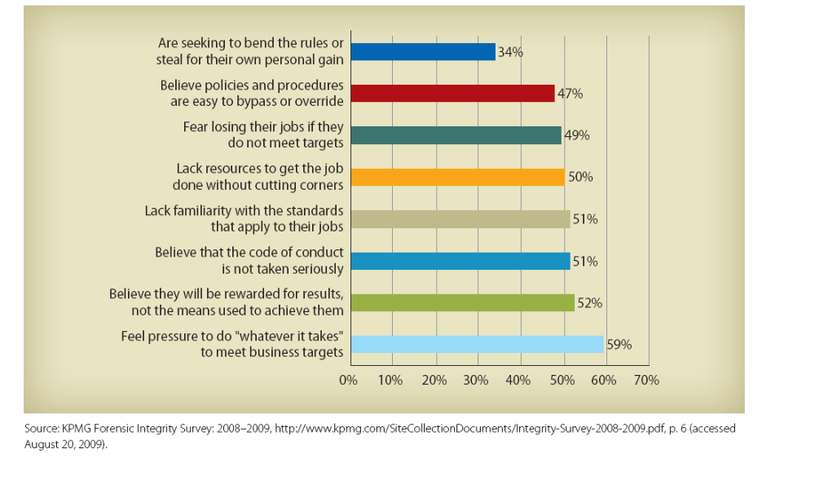
Causes of Misconduct

Slide 19
The Need for Corporate Ethics Programs
Scandals in corporate America have reduced trust in businesses
Understanding the factors that influence ethical decision-making can help companies encourage ethical behavior
Employees are not legal experts and need guidance

Slide 20
The Need for Corporate Ethics Programs
Organizations should develop an organizational ethics program by establishing, communicating, and monitoring uniform ethical values and legal requirements
A strong ethics program includes:
  Written code of conduct
  Ethics officer to oversee the program
  Care in the delegation of authority
  Formal ethics training
  Auditing, monitoring, enforcement, and revision of program standards

Slide 21
An Effective Ethics Program
Helps ensure that all employees understand the organization’s values and comply with the policies and codes of conduct that create its ethical climate
  Cannot assume that employees will know how to behave when entering an organization
Source: Digital Vision

Slide 22
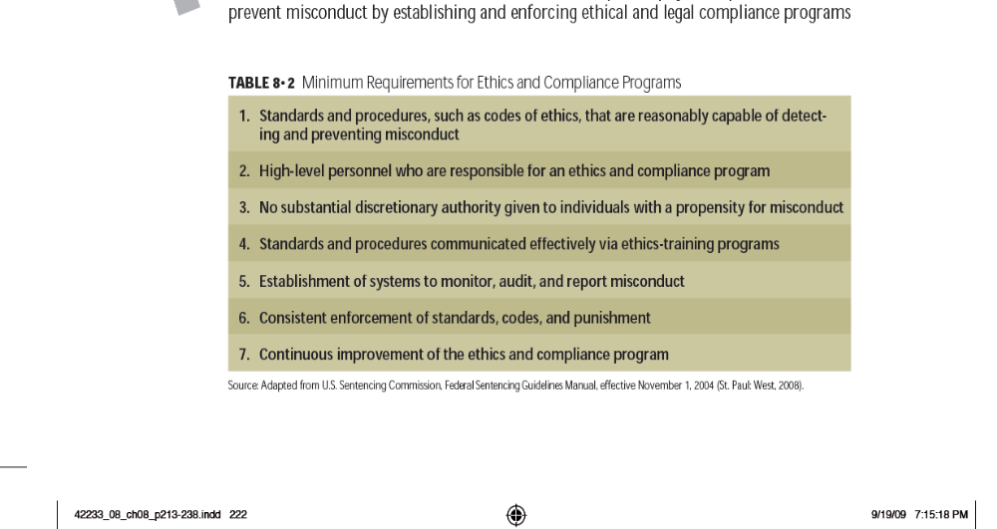
Minimum Requirements for Ethics and Compliance Programs

Slide 23
Values Versus Compliance Orientation
Compliance orientation
  Requires that employees identify with and commit to specified conduct
  Uses legal terms, statutes and contracts that teach employees the rules and penalties for noncompliance
Values orientation
  Focuses more on an abstract core of ideals such as respect and responsibility
  Research shows that this is most effective at creating ethical reasoning

Slide 24
Codes of Conduct
Codes of conduct
  Formal statements that describe what an organization expects of its employees
Codes of ethics
  Most comprehensive document
  Consists of general statements that serve as principles and the basis for the rules of conduct
Statement of values
  Serves the general public and addresses stakeholder interests

Slide 25
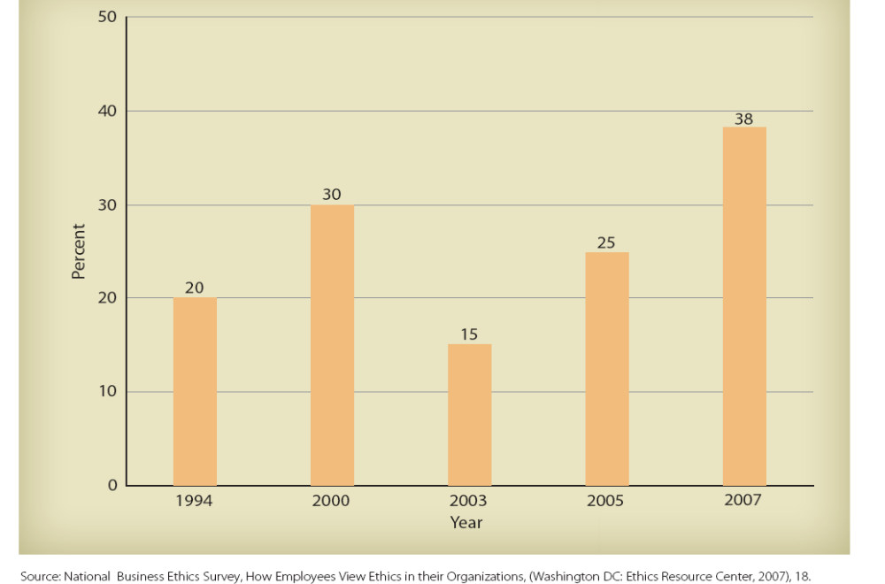
Percentage of Employees Who Identify Comprehensive Codes of Ethics and Compliance in their Companies
Notes:
The prevalence of corporate codes of ethics is on the rise

Slide 26
Corporate Codes of Ethics
Often contain six core values
  Trustworthiness
  Respect
  Responsibility
  Fairness
  Caring
  Citizenship
Source: Triangle Images

Slide 27
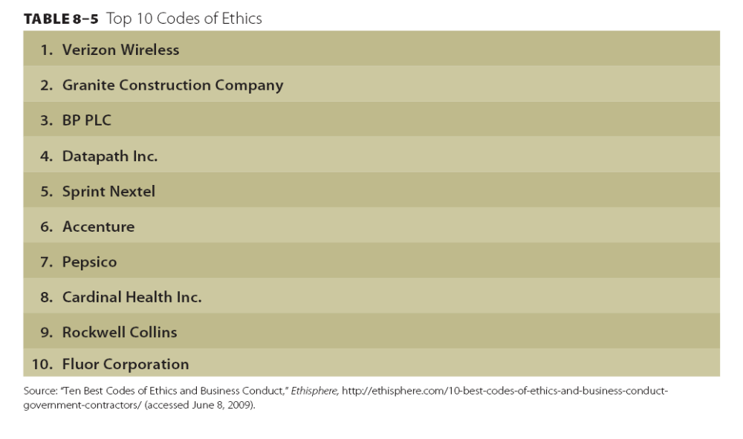
The Top Ten Corporate Codes of Ethics

Slide 28
Ethics Officers
Ethics officers or committees are responsible for oversight of the ethics/compliance program
  Assess the needs and risks that an ethics program must address
  Develop, revise, and disseminate the code
  Conduct training programs for employees
  Develop effective communication
  Establish audits and control systems
  Review and modify the program to improve effectiveness

Slide 29
Ethics Training and Communication
Must start with a foundation, a code of ethics, a procedure for airing ethical concerns, and executive priorities on ethics
  Can educate employees about firm’s policies and expectations, laws and regulations, and general social standards
  Can make employees aware of resources, support systems, and personnel who can assist them with ethical advice
  Can empower employees

Slide 30
Systems to Monitor and Enforce Ethical Standards
An effective ethics program employs many resources to monitor ethical conduct and measure the program’s effectiveness
  Observing employees
  Internal audits
  Surveys
  Reporting systems
  Investigations
  Independent audits
Source: Digital Vision

Slide 31
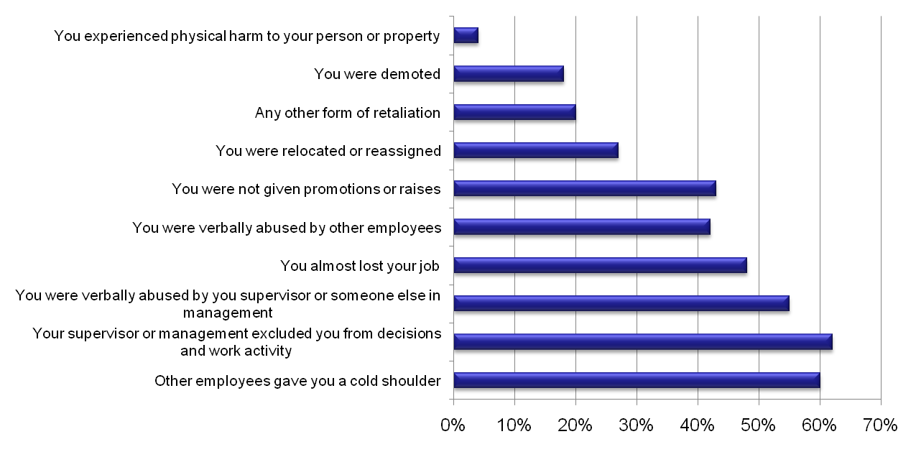
Forms of Reported Retaliation Experienced as a Result of Reported Misconduct
Source: 2009 National Business Ethics Survey, Ethics Resource Center, p. 36

Slide 32
Continuous Improvement
Implementation requires designing activities to achieve organizational objectives using available resources and existing constraints
Depends in part on how an organization structures resources and activities to achieve its ethical objectives
Source: Stockbyte

Slide 33
Common Mistakes in Designing/Implementing an Ethics Program
Not having a clear understanding of the goals of the program from the beginning
Not setting realistic and measurable program objectives
Senior management’s failure to take ownership of the ethics program
Developing program materials that do not address the needs of the average employee
Transferring a domestic program internationally
Designing a program as a series of lectures

Slide 34

Offshore and Onshore Software Development Models
Offshore
The offshore software development indicates that the company of providers is located in a foreign country far away from your country. It can be even the different continent thus the customers might face the notable time zone difference.

Slide 35

Offshore and Onshore Software Development Models
Onshore
When the company decides to hire the software developers within their own country, it is onshore outsourcing. They find this option rather convenient and approachable. For instance, the company can choose the provider just from the different region of their country.

Slide 36
Offshore software development advantages
Cost cut down – It is known that you can reduce the expenses by hiring remote programmers. Their salaries will be lower than the in-house developers’. And at the same time, you don’t spend money on facilities, utilities, and equipment.
Talented and skilled specialists – Different countries have a wide talent pool of professionals. They are the graduates of tech universities that constantly improve their tech skills, take part in various IT conferences and competitions.
The balanced approach of management – The customer is in control of managing their project developers. You can always choose how many and what developers you need. However, it will not be time-consuming as the offshore software company is always there for you.
Know-how – The majority of offshore development companies specialize in particular technologies. They keep on improving employers’ skills. Regular training and gaining new experience are held on a regular basis. As long as you look for experts, offshore programming will definitely have the payoff.

Slide 37
Offshore software development disadvantages
Communication issues – Sometimes communication may slow down due to time zone difference. Actually, it is about dealing with the issues timely, but in other cases, there are many modern ways of communication like video calls, email correspondence or even instant messaging. It will just require a little bit more organization and coordination
Cultural difference – It is recommended to consider this criterion because of the cultural barriers and different work ethics. The USA, Canada, Australia find the Eastern European mindset pretty similar whereas some companies have failed the communication establishment in Asia and the Middle East. Eastern mindset is quite different from the European one.

Slide 38
Onshore software development advantages
They are great for a complex project, as face-to-face communication and in-person collaboration make the developing process faster and more transparent, as there will be fewer communication delays and language misunderstandings.
The more straightforward hiring process makes it easier to connect with the right team.
There is no time overlap between the working hours of your team and the developers.
There is apparent familiarity regarding the work culture.
It is easy to keep your systems agile.

Slide 39
Onshore software development disadvantages
The costs will be significantly higher in comparison with the rates for the same services you can get from offshore developers.
The range of services is narrower, as offshore companies can afford to keep more developers and engineers.
There is a smaller talent pool that limits the choices.
Miscommunication due to corporate cultural factors may still be a problem.

Slide 40
Helpful sites:
ACM Professional Code of Conduct
  http://www.acm.org/constitution/code.html
ACM Software Engineering Code of Ethics http:/www.computer.org/tab/seprof/code.htm
ACM Public Policy Statements
  http://www.acm.org/usacm

Slide 41
References
Gotterbarn, D., Miller, K., Rogerson, S., “Software Engineering
Code of Ethics”, Communications of the ACM 40, 11 (Nov. 1997),
pp. 110-118.
Gotterbarn, D., Miller, K., Rogerson, S., “Software Engineering
Code of Ethics is Approved”, Communications of the ACM 42, 11
(Oct. 1999), pp. 102-107.
Gottenbar, D. “A Positive Step Toward a Profession: The Software
Engineering Code of Ethics and Professional Practice”, AMC
SIGSOFT Software Engineering Notes 24, 1 (Jan. 1999), pp. 9-14

